Slide 1

N
Zapl-Earn
Exploring the World of Selling and Buying Development Services
Name
Seat no.
Singh Satish Lalan
6310
Rai Preeti AK
6224
Tohfafarosh Murtaza Khozema
6367
Parikh Vrushil
6160
1

Slide 2
About
Earning through A to Z programing languages
The freelancing website is an online platform that connects clients and freelancers from around the world. The website's primary purpose is to provide a secure and efficient environment where clients can post projects and freelancers can apply for them. The website will also enable clients and freelancers to communicate, negotiate project details and pay securely
12
k
120
+
Solopreneur
Completed Projects

Slide 3
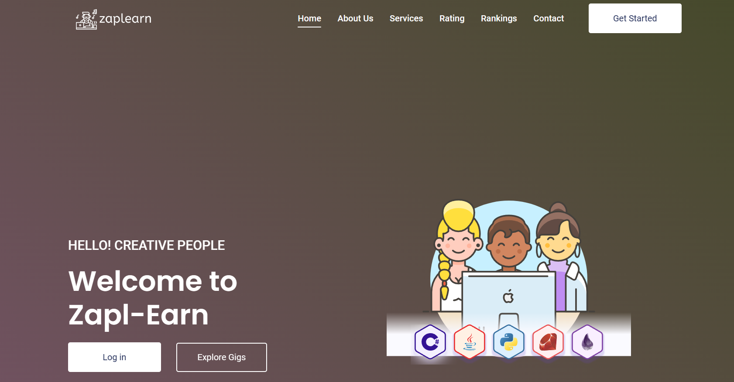
Landing Home Page
Zapl-Earn tries to offer the best services to the clients from freelancers. It also serves the purpose of clients by helping them provide the services.
3

Slide 4
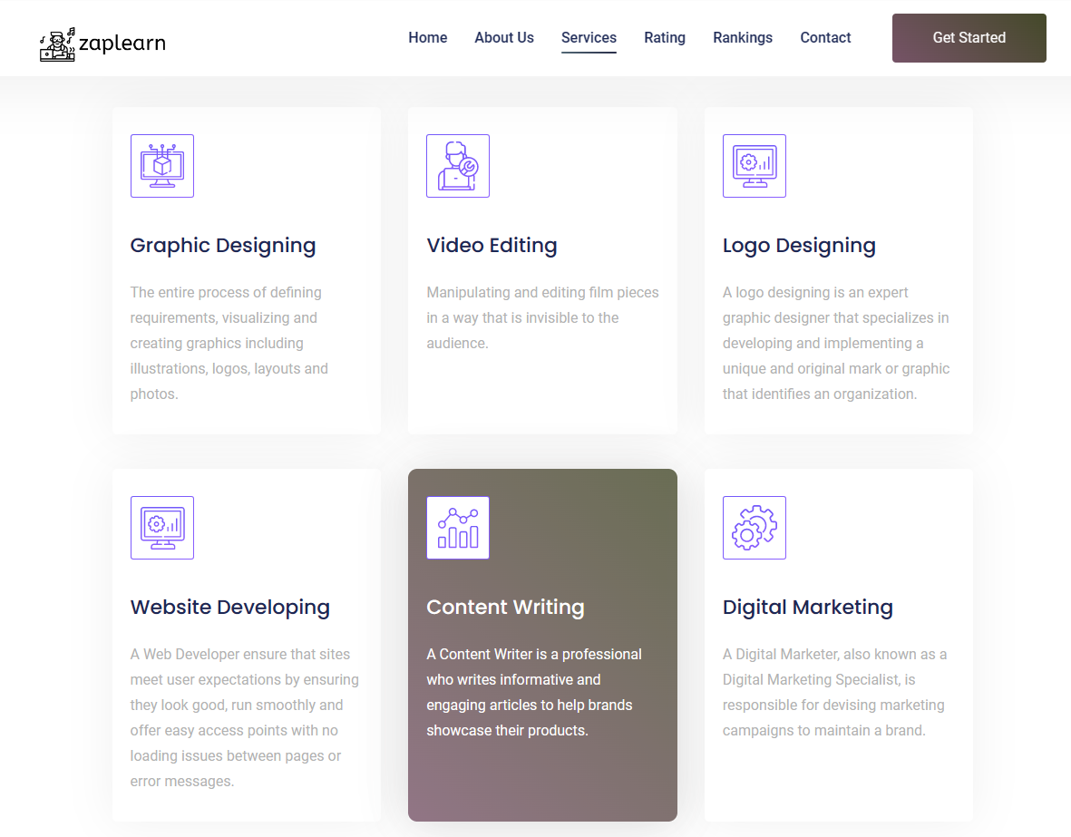
We provide services encompassing video editing, development, graphic design, content writing, and more.
Discover comprehensive website services including video editing, development, graphic design, content writing, and beyond. Unlock your digital potential with our versatile expertise.
4
Industrial
Analyze
Research
Business
Environment
Mining
Opportunities
Creative
social
Compatible

Slide 5
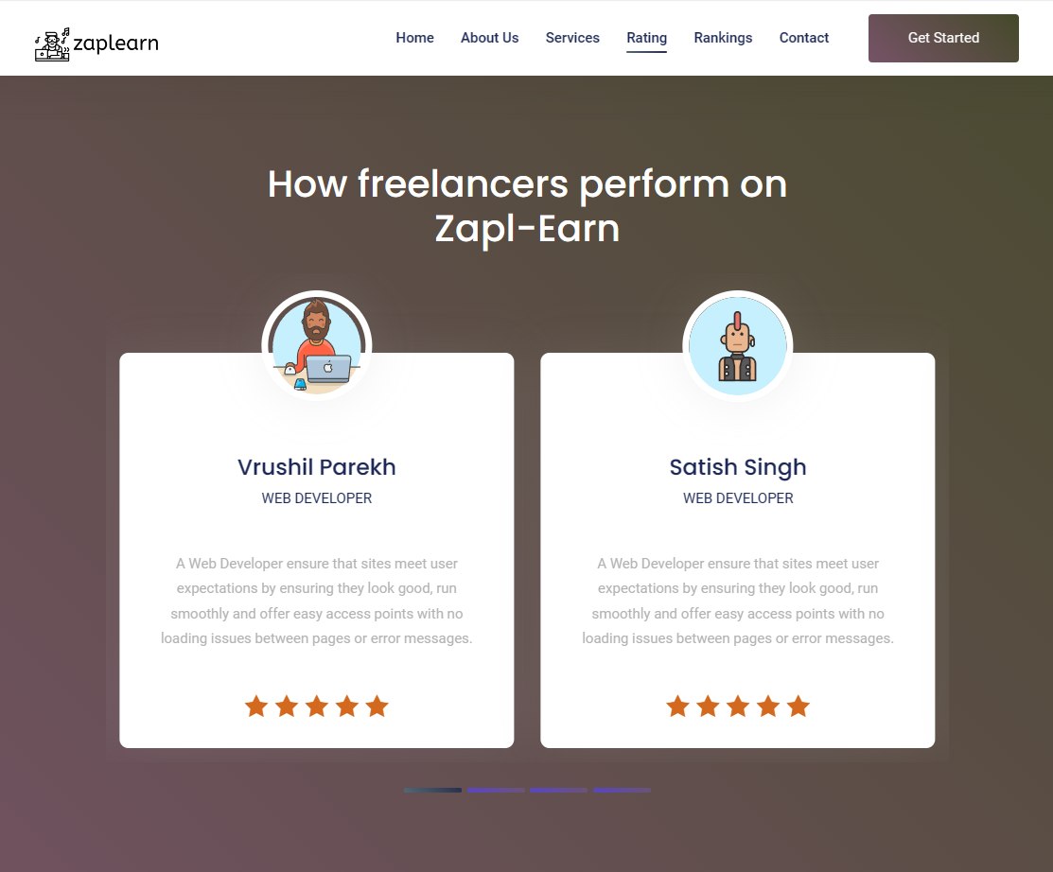
Rating
How freelancers perform on Zapl-Earn
Freelancers thrive and excel on Zapl-Earn, turning their skills into rewarding opportunities.
5

Slide 6
Gigs Number of users and their providing servicies
Chats
Here user can chat with client for requirements and services they want
Profile as
Buyer
Order
Here user can check the status of his order
12
k
Solopreneur
6

Slide 7
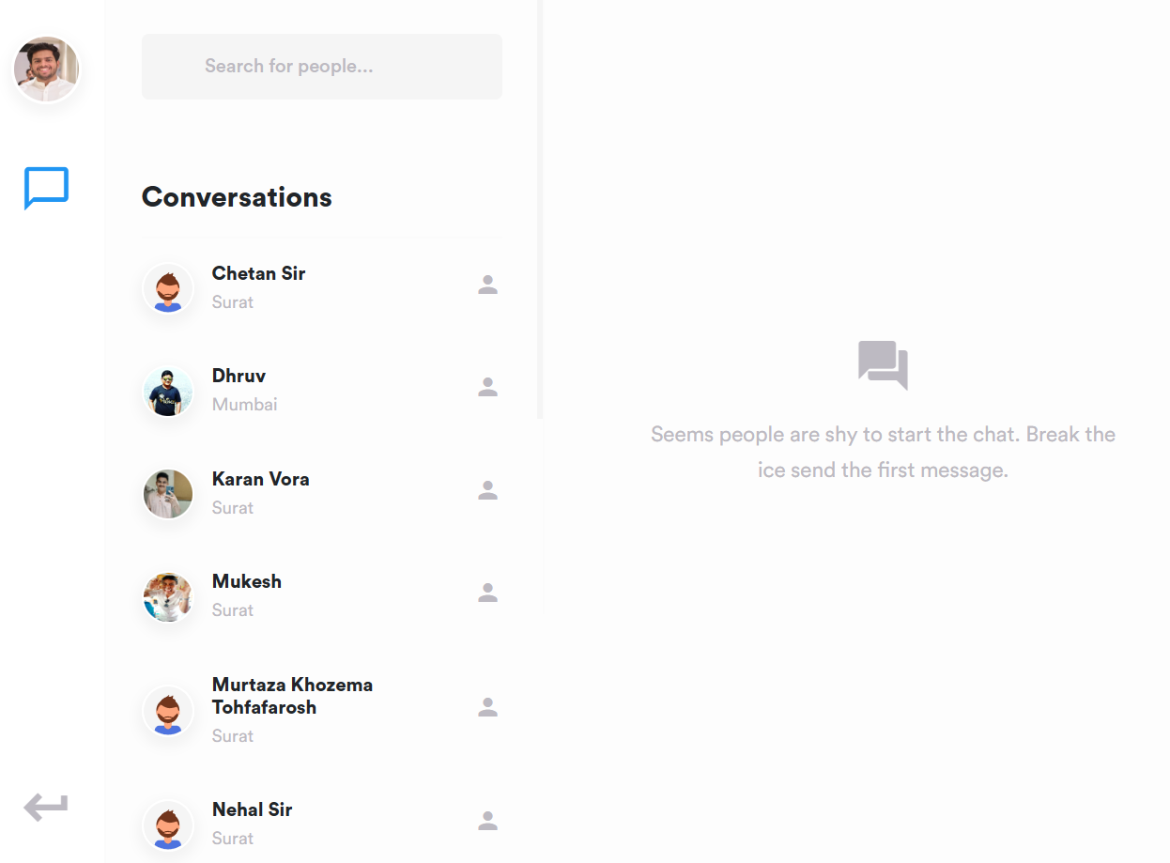
Empower your business with seamless communication: sellers effortlessly connect with clients, and clients engage directly with skilled professionals for work-related discussions, all within our intuitive chat box feature.
Chatting
02
User can chat
01
Enhance your business dynamics: Our intuitive chat box facilitates direct communication between sellers and clients, fostering productive discussions and collaborations among skilled professionals for work-related tasks.
Searching
03
User can search by name
7

Slide 8
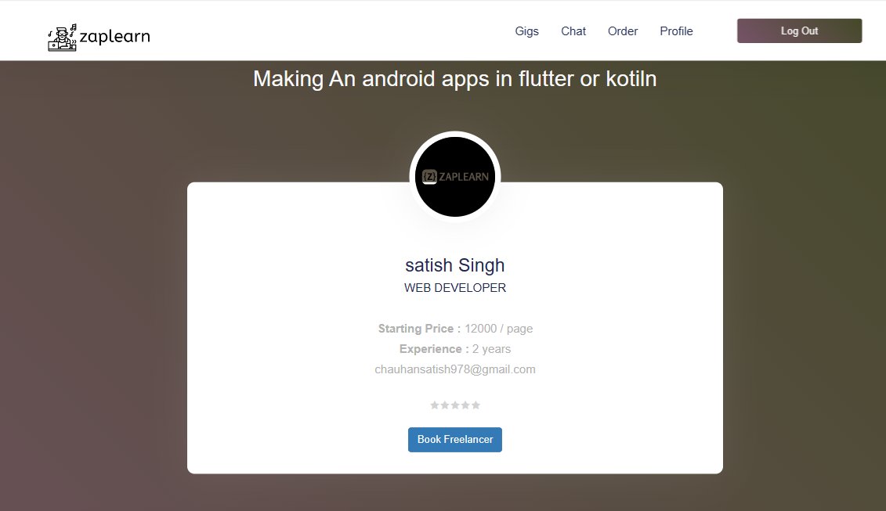
Empowering clients with easy access to freelancer profiles for seamless collaboration
8

Slide 9
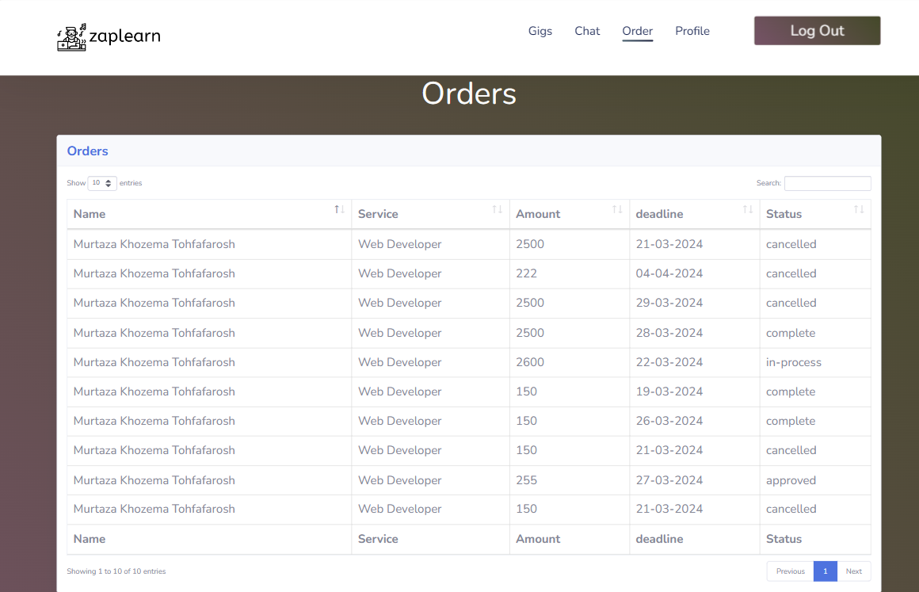
Zapl-Earn
Description
Name
Description
Stay informed about your project's progress with our simplified status updates: Started, Completed, In Progress, Pending, or Declined. Keep in touch for real-time insights into every detail
Service
Description
Amount
Description
Deadline
01
Description
Status
9

Slide 10
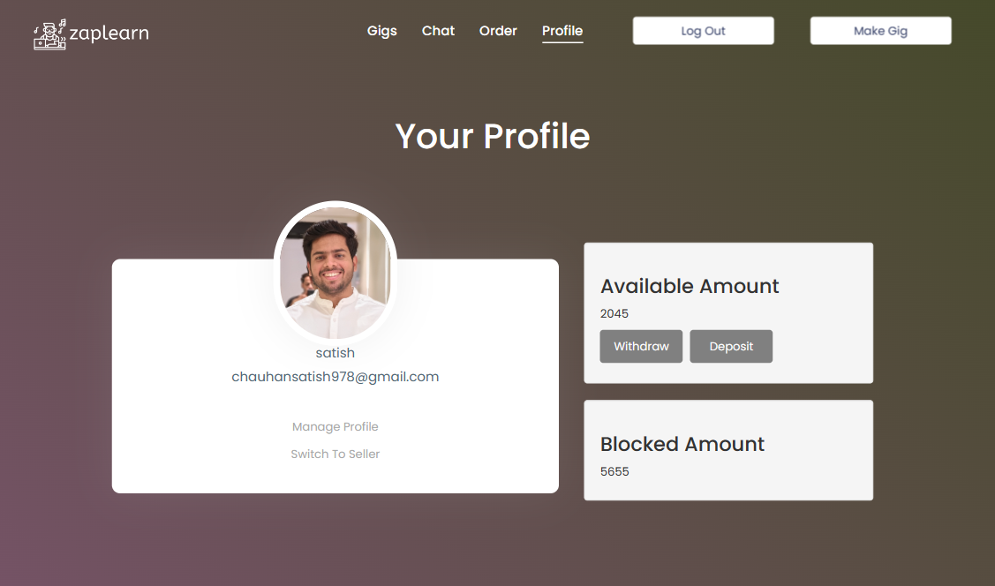
Zapl-Earn
Deposit
Money
Experience hassle-free fund deposition with just a click. Simply tap the 'Deposit' button to add funds effortlessly.
Za
pl
Withdraw
Money
Effortlessly withdraw funds by simply clicking on the 'Withdraw' button. Seamlessly manage your finances with ease.
Switch to Seller
Easily transition between roles with a single click. Seamlessly switch your profile from buyer to seller and vice versa, putting you in control of your online presence
Ea
rn
Manage
Profile
Take charge of your profile with ease. Simply click on the 'Manage Profile' button to access and customize your settings effortlessly.
10

Slide 11
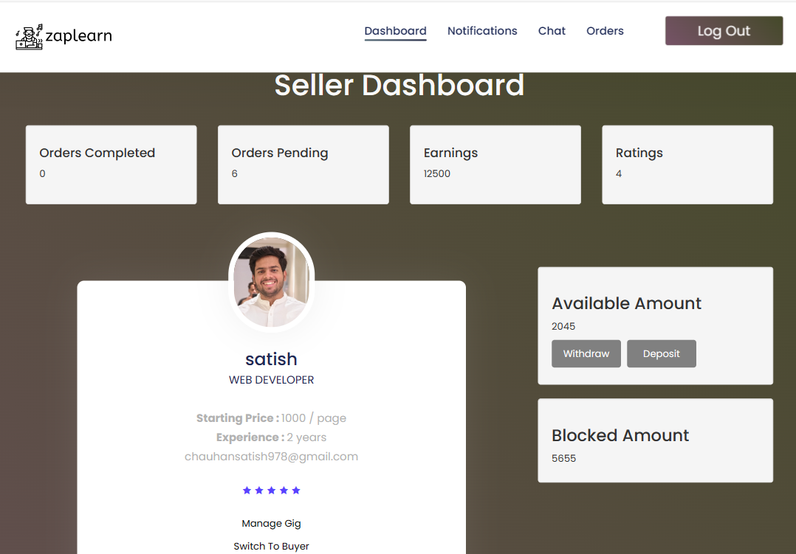
Zapl-Earn
Orders
Completed
massive x
01.
Seller can see the number of orders are completed
02.
Orders
Pending
Seller can see the number of order are pending
03.
Earning
Seller can see the amount total they earned form the Zapl-Earn
04.
Ratings
By Clients
11
Seller can also see the ratings given by the buyer as per service

Slide 12
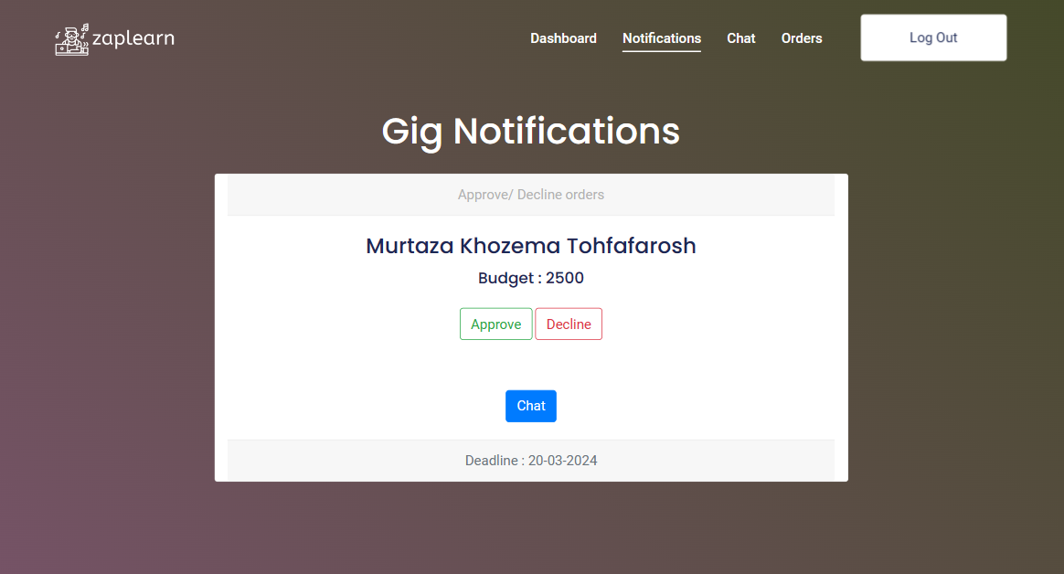
Introducing our Notification Center: Stay informed, sellers, with real-time alerts for new orders. Never miss a beat in managing your workflow efficiently.
Approve
Seller Accepted the Work request
Business
Portfolio
Art
Discussion
Chart
Deck
Chat
Seller can chat with the service buyer as per project regarding
Business
Portfolio
Art
Decline
Discussion
Chart
Deck
Seller declined on the working of buyer project
Business
Portfolio
Art
Discussion
Chart
Deck
12

Slide 13

Simplify payments: our intuitive payment gateway streamlines the payment process, ensuring a frictionless experience for all users
13

Slide 14
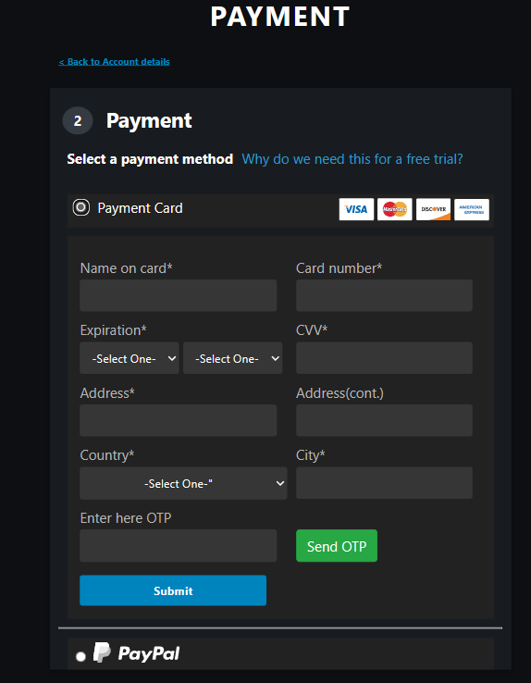
Fill All Detail
Ask For OTP
OTP Verification
01
02
03
First It Will Check to Fill All credentials
After Process 1 it will go for further process :-- for OTP generation
After Generating OTP then it will verify the OTP is valid or not
14

Slide 15
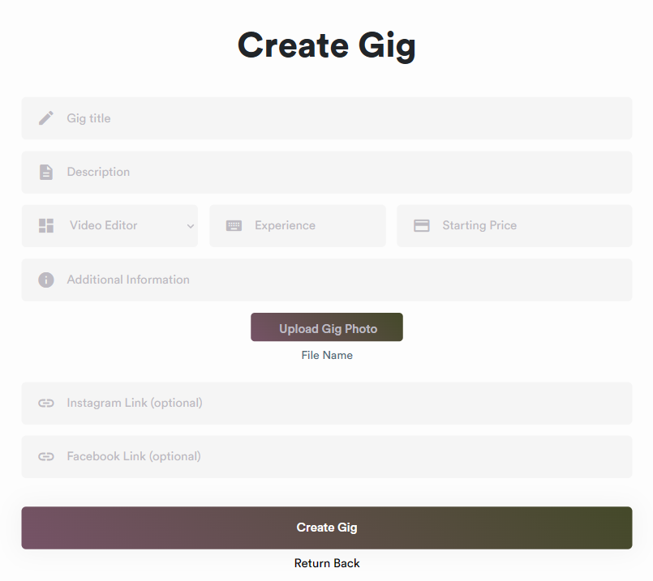
Gig title
Starting Price
To become a service provider on ZapLearn, prospective sellers must possess at least one IT-related skill. By agreeing to our privacy and policy guidelines, individuals can seamlessly transition from buyer to seller, offering their expertise to our community with confidence.
Skill
Starting Price
Upload Gig Photo
15

Slide 16
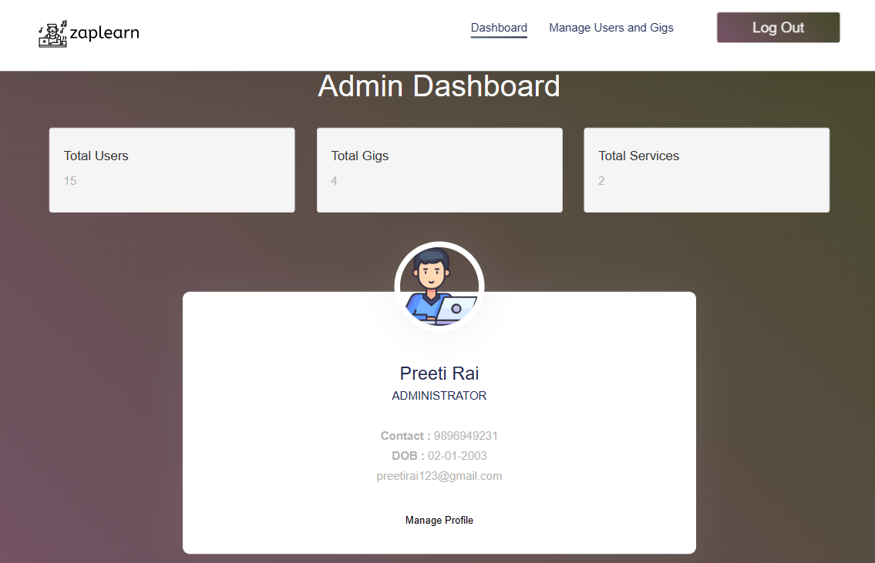
Efficiently manage and oversee all platform activities with our comprehensive admin dashboard.
Manage All Profiles
Authority to Block user
Delete Profiles
16

Slide 17
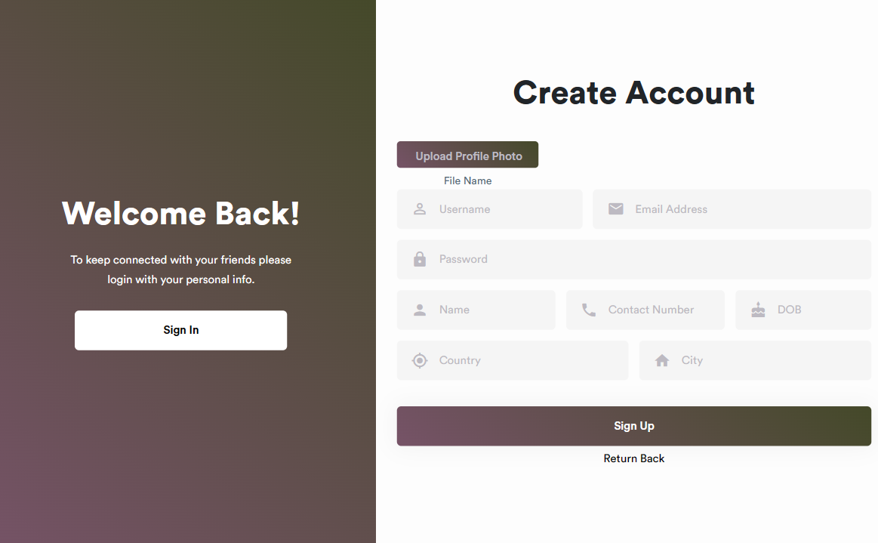
01.
Username
02.
Email
Address
Unique username
Valid Email Addreess
03.
Password
04.
DOB
Password must be Strong
Date-of-Birth(2003-02-11)
17

Slide 18
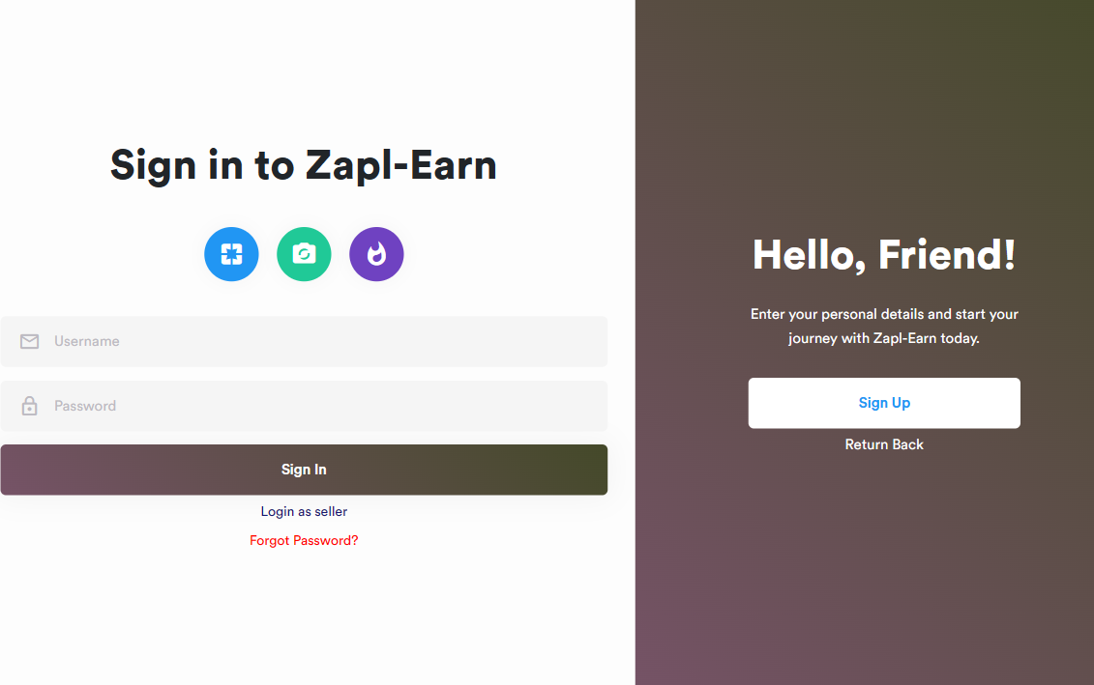
Valid Email >
Correct Password >
A valid email address is essential for communication and account verification purposes
Ensure account security with the correct password.
Forgot Password >
Login as Seller >
Easily reset your password with our 'Forgot Password' feature.
Access your seller account securely with a single login.
18

Slide 19
Streamline analytics: Our intuitive platform integrates seamlessly with Google Analytics, ensuring a frictionless experience for all users.
19

Slide 20
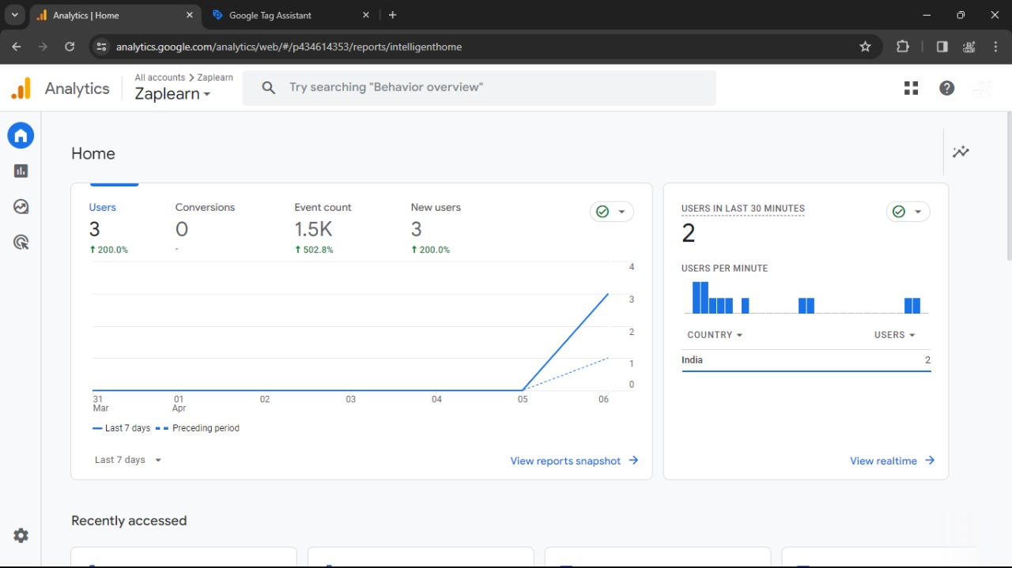
Home With Event Count
Number or users
Last 30 Minutes
01
02
03
Total Number of users Visited
Number of Event performed
Latest users in last 30 min
20

Slide 21
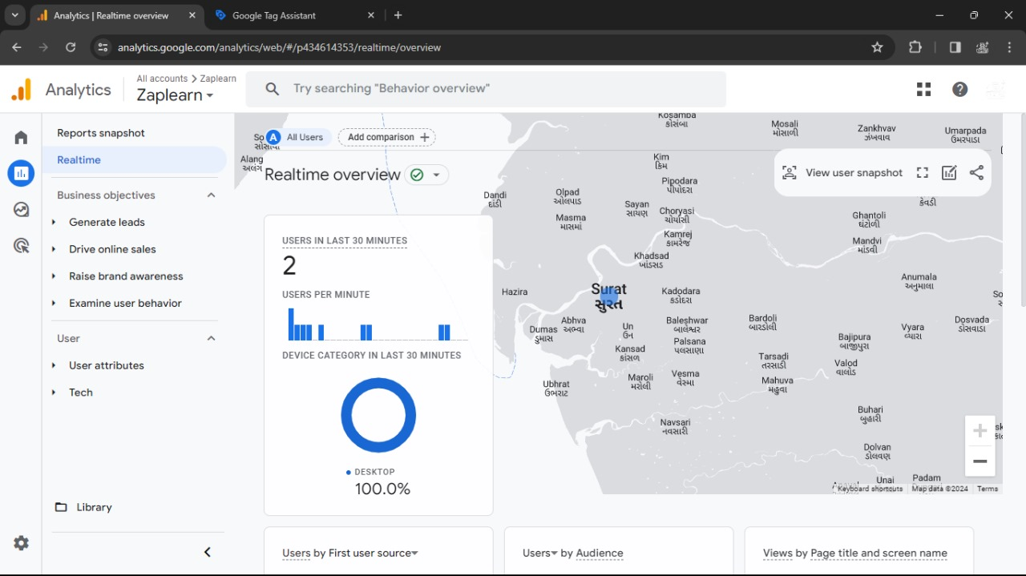
Real Time Report
Real-Time Report provides immediate insights into website activity, displaying live data on user interactions, such as pageviews, events, and conversions, allowing for real-time monitoring of website performance..
User current location
Users Device Category
User Per Minute
View Current Precise location
21

Slide 22
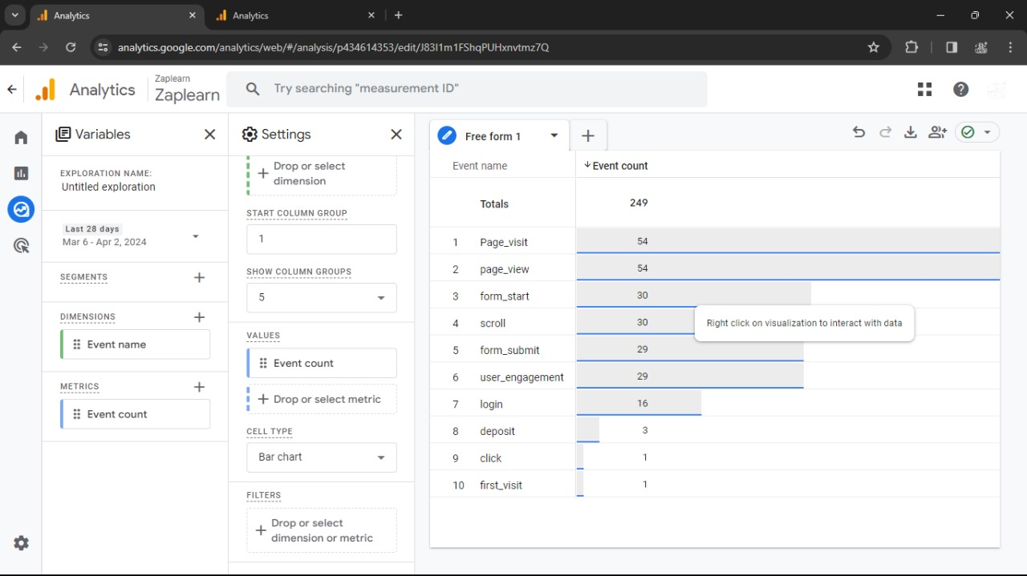
Efficiently manage and oversee all platform activities with our comprehensive admin dashboard.
Total Events
Event Counts
Specific Duration
22

Slide 23
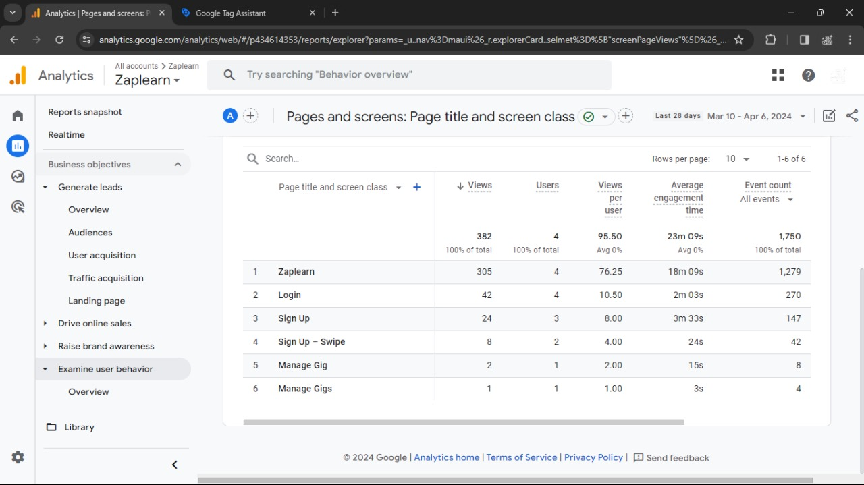
01.
User Behavior
02.
Page Title Screen Class
User movement on page
Show Visited Pages Title
03.
View Per User
04.
User Engagement Time
View Percent of per user
Average time spent by user
23

Slide 24
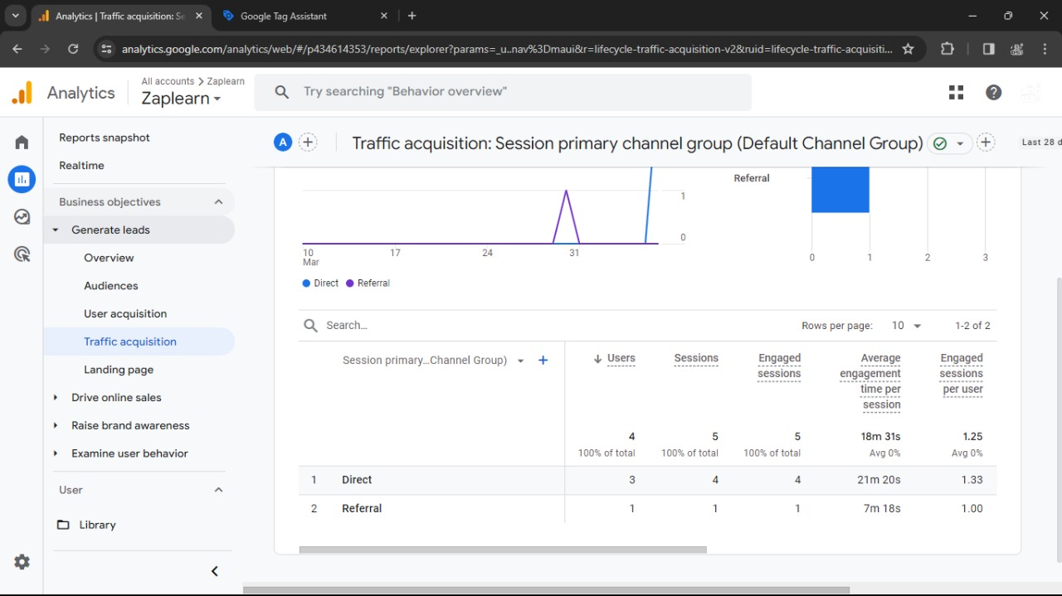
Traffic Acquisition>
Channel Group>
tracks visitor origins, assessing marketing campaigns
categorizes website traffic into distinct channels.
Engaged Session per user >
Avg engagement Time per user >
measures the depth of interaction on a website, reflecting user engagement levels accurately..
measures the duration visitors spend interacting with a website, indicating user engagement levels.
24

Slide 25

References
https://www.w3School.com/
https://docs.geekforgeeks.org/
https://www.exercism.com/
https://developer.mozilla.org/en-US/https://app.diagrams.net/ https://stackoverflow.com/ https://analytics.google.com/analytics/web/?authuser=0#/p434344854/reports/intelligenthome?params=_u..nav%3Dmaui
Explore endless freelance possibilities with Zapl-Earn, the premier freelancing platform where talent meets opportunity
VISIT Zapl-Earn>

Slide 26

Thank you for your attention
A
Option Two
Donec ornare rutrum neque sit amet pellentesque. Nulla eget dictum tortor.

